Slide 1
Group Album Project
Digital Media 1
Spring 2016

Slide 2
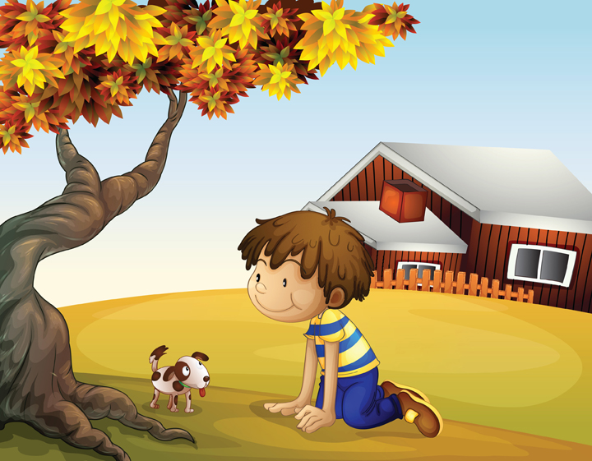
Multi-Unit Project:
Objective 103 – Understand concepts and
Methods used to create digital graphics.
Objective 105 – Understand concepts
and methods used to create digital audio.

Slide 3
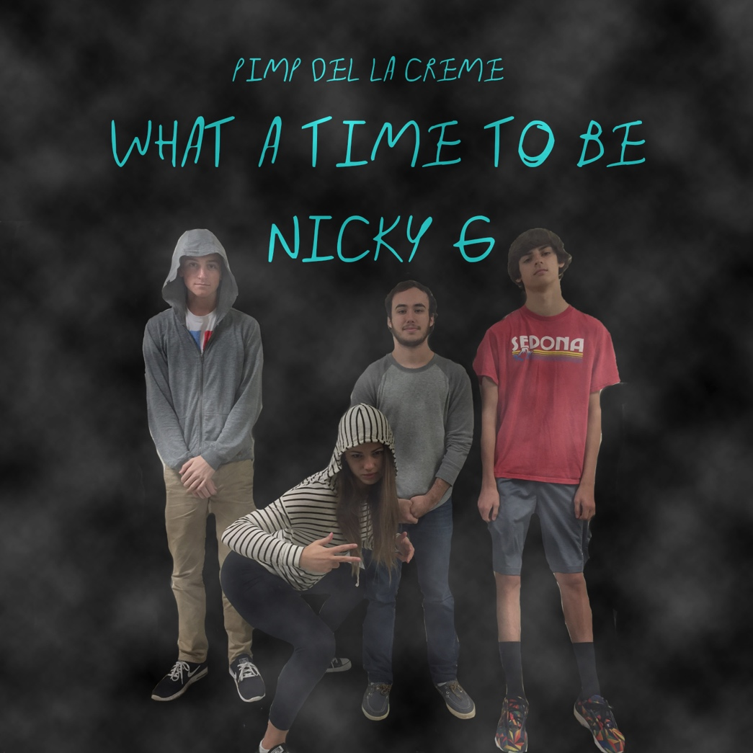
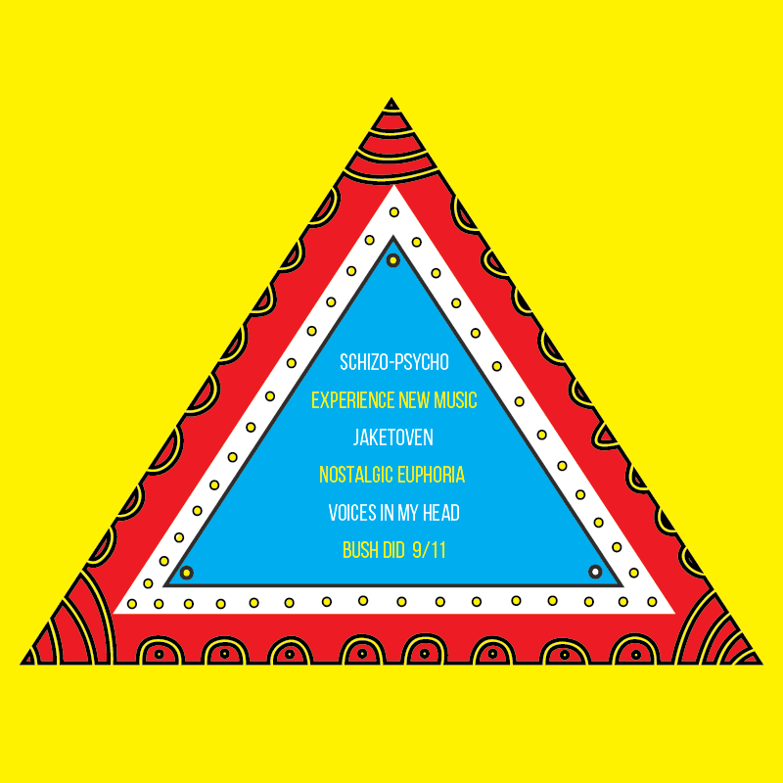
What is a Group Album?
Multiple Songs
Front & Back CD Cover Designs
4 Group Members
One Common Theme/Genre

Slide 4
Parameters of Project:
Each group member must create 2 original songs in GarageBand
Each song must be original and predominantly be composed of loops with only 10-15% being remixed from a copyrighted song
Each individual song must be at least 1:30 minutes long
One Group Member will design the Front Cover
One Group Member will design the Back Cover (Must include the track list along with the artist/group member’s name.)
One common musical theme/genre across the group!

Slide 5
2nd Period Groups:
Group #1 (Daisya, Tangela, Jasmine, Karise)
Group #2 (Nick, Davonte, Bryn)
Group #3 (Josh, Matt, Cole, Adam)
Group #4 (Wesley, Ben Schneier, Sam, Ethan)
Group #5 (Brendon, Jim, Ben Seabolt, Erika)
Group #6 (Jessi, Snow, Maddie, Sana)

