Slide 1
Objective 101.02 Explain safety and legal issues in the digital media environment.

Slide 2
LEGAL TERMS IN DIGITAL MEDIA
Intellectual Property
Copyright
Original creations of the mind that can be protected by law; literary and artistic works, designs, symbols, images, names, etc.
The exclusive legal right to reproduce, publish, sell or distribute the expression of an intellectual property (literature, design, audio, video, etc.)

Slide 3
LEGAL TERMS IN DIGITAL MEDIA
Trademark
Fair Use
A mark (logo, symbol, word, phrase, etc.) legally registered or established by a company to represent a service or product; cannot be used without the permission of the owner.
A legal allowance of using a copyrighted material without permission from the owner, provided the circumstances are reasonable and do not make the material less profitable.

Slide 4
QUESTIONS TO CONSIDER
Differentiate between:
Intellectual property
Copyright
Trademark
Fair Use
What can be copyrighted?
Does a copyright mean it can’t be used?

Slide 5
FAIR USE GUIDELINES
For use of media to fall under fair use guidelines, the following factors must be considered:
Purpose and character of use—is it for commercial or non-profit education use.
What is the nature of the copyrighted work.
The amount of the portion being used.
The effect of the use on the potential market value of the product.

Slide 6
CREATIVE COMMONS
A nonprofit organization that enables the sharing and use of creativity and knowledge through free legal tools.
Free, easy-to-use copyright licenses provide a simple, standardized way to give the public permission to share and use your creative work — on conditions of your choice.
Creative Commons licenses are not an alternative to copyright. They work alongside copyright and enable you to modify your copyright terms to best suit your needs.

Slide 7
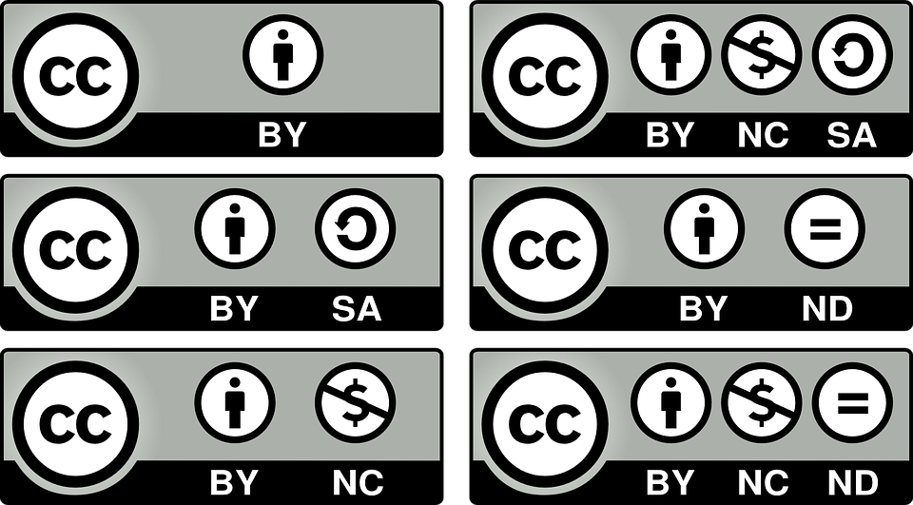
TYPES OF CREATIVE COMMONS
Creative Commons Video
Creative Commons Licenses
Six types with different features

Slide 8
QUESTIONS TO CONSIDER
Explain how a copyrighted work could be used under Fair Use guidelines.
Which Creative Commons license could you use
For an educational project?
For a company logo?
For a song that you wanted to use in a mix?

Slide 9
LEGAL TERMS IN DIGITAL MEDIA
Plagiarism
Libel
Taking someone else’s work or ideas and passing them off as your own.
A published (written or printed) false statement that is damaging to a person’s reputation or success.

Slide 10
LEGAL TERMS IN DIGITAL MEDIA
Slander
Invasion of Privacy
An oral (spoken) false statement that is damaging to a person’s reputation or success.
Intruding into someone’s personal space, using their image or likeness, or revealing information about them without their permission.

Slide 11
PHYSICAL SAFETY ISSUES
Electrical Hazards
Electrical connections not handled properly, may result in electric shock, burn, or other injury.
Tripping Hazards
Connecting cables not managed properly, could result in blocked walkway or tripping hazard.
Ergonomics
Designing the workplace to best fit the worker, reducing strain on the body and enhancing comfort during digital media creation.

Slide 12
DIGITAL SAFETY ISSUES
Cyberbullying
Identity Theft
When a person is threatened, harassed, humiliated, tormented, or otherwise targeted using the Internet, mobile phones, or other digital technology.
When personal information (SSN, credit card number, passwords, etc.) is stolen and used to gain access to financial or personal accounts.

Slide 13
DIGITAL SAFETY ISSUES
Virus/Malware
Spam
Programs that are specifically designed to damage a computer when installed; can access personal information, corrupt files, and even erase the hard drive completely.
Unwanted emails (usually sent in a large volume) that advertise products or promote services that were not requested by the recipient.

Slide 14
DIGITAL SAFETY ISSUES
Online Hoax
Internet Addiction
A false claim that is spread through electronic means (email, social media, blogs, etc.); examples include chain letters, untrue accusations, etc.
Compulsive disorder that causes an unhealthy obsession with the Internet and other digital resources; examples include online gambling addiction, cybersex addiction, social media addiction, etc.

Slide 15
QUESTIONS TO CONSIDER
What are some ways to prevent or avoid
Identity Theft?
Virus/Malware?
Spam?
Online hoax?

